Slide 1
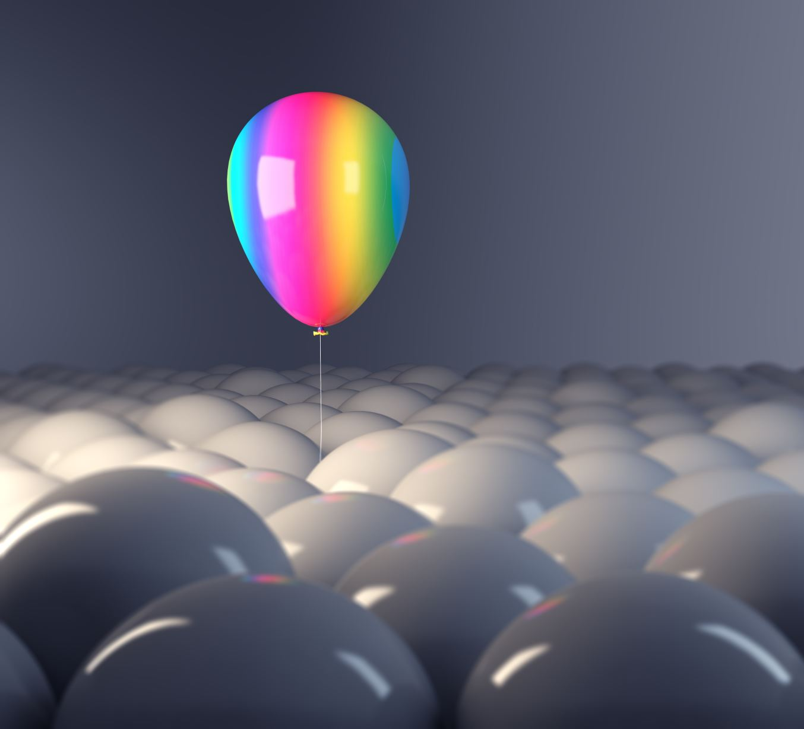
AUS Hackathon
Wild Animal Rescue

Slide 2
Goal

Slide 3
How does it work?

